Slide 1
Histogram Equalization
OBJECTIVES
1. Define histogram equalization
2. Derive formula in continuous domain
3. Examples
4. Implementation

Slide 2
Definition
A(x, y) - Input
B(x, y) - Output
H_{A}(D_{A})
H_{B}(D_{B})
D_{A}
0
D_{B}
0
255
255

Slide 3
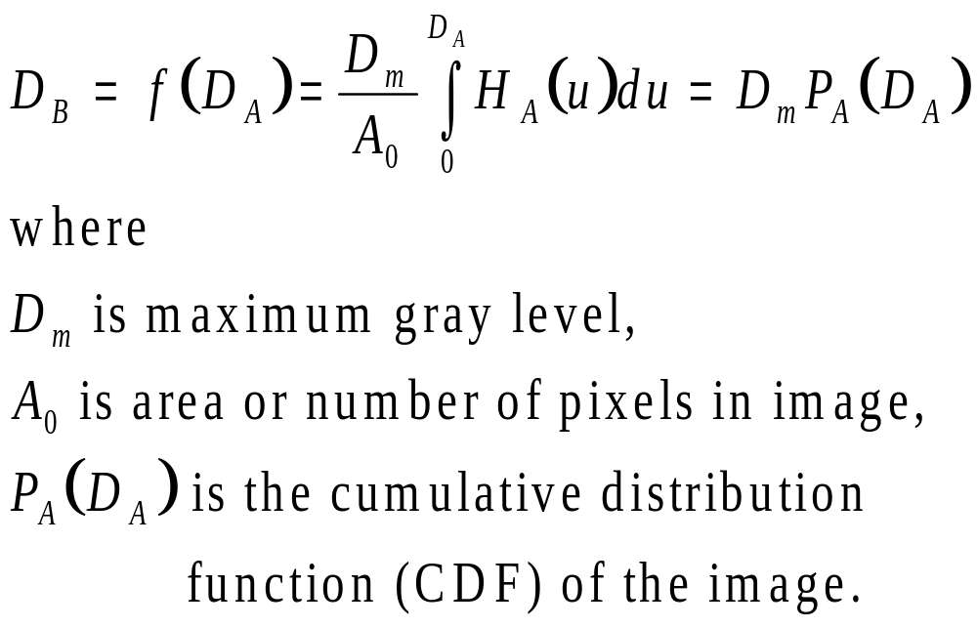
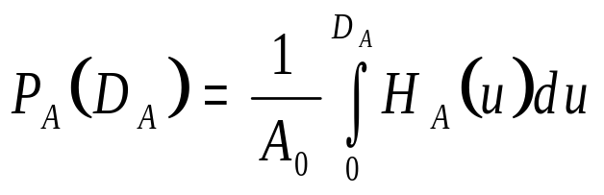
Continuous-Domain Formula
The point operation f(D_{A}) that flattens the histogram, H_{A}(D_{A}), of the input image is:
NOTES:
u is a dummy variable of integration
the CDF is given by:

Slide 4
Example – Continuous
Derive a GST that will flatten H₁ (i.e., equalize corresponding image) where:

Slide 5
Implementation - Discrete Case
The discrete formula for implementation purposes is:
E.g., consider equalizing the following 4-bit image using the above formula:

Slide 6
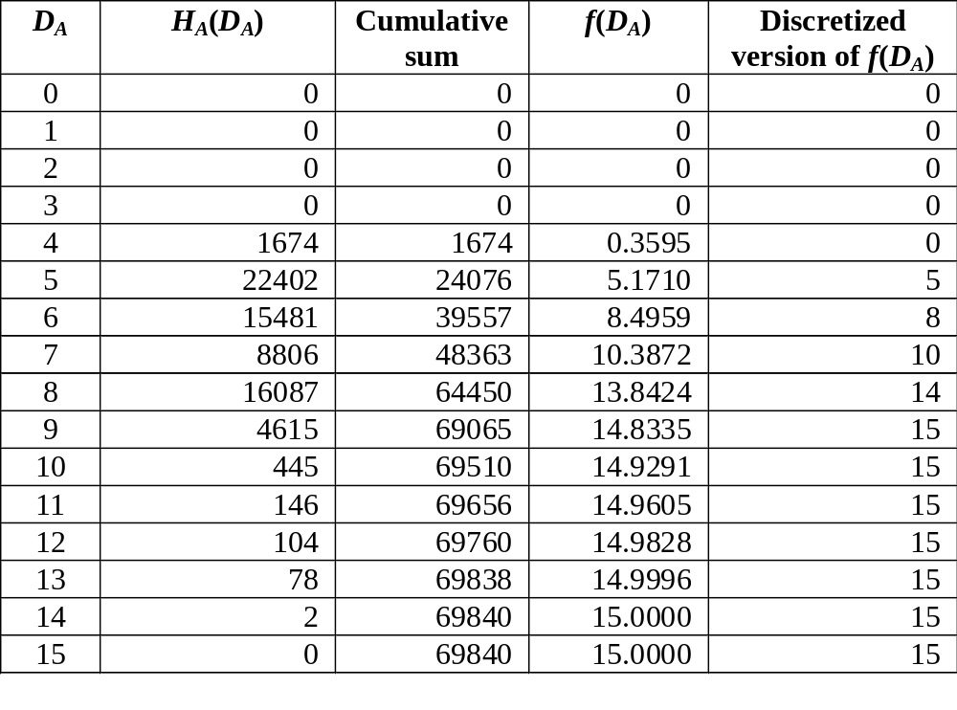
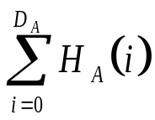
Implementation Example
D_{m} = ? A₀ = 69840 (given)
1. Obtain histogram, H_{A}(D_{A}), of input image.
2. For each input gray level, D_{A}, compute the cumulative sum
3. For each D_{A}, scale sum by D_{m} / A₀.
4. Discretize f(D_{A}).
5. Replace each gray level D_{A} in the input image by the corresponding value of f(D_{A}).

Slide 7
Example
Before
After

Slide 8
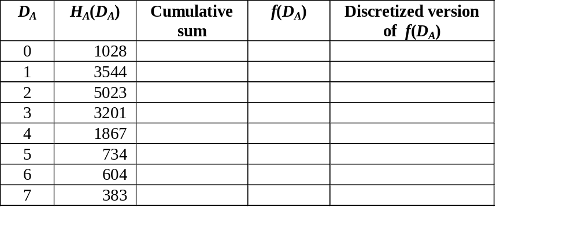
Applying a GST to an Image
Find a point operation (in tabular form) that will equalize a 3-bit image with the following histogram:

Slide 9
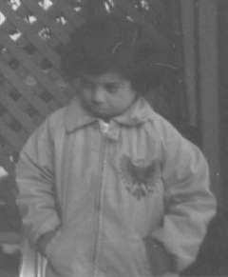
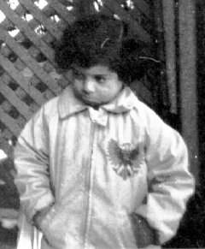
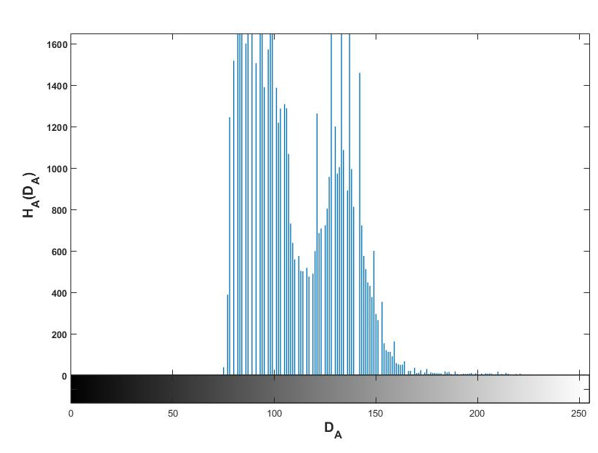
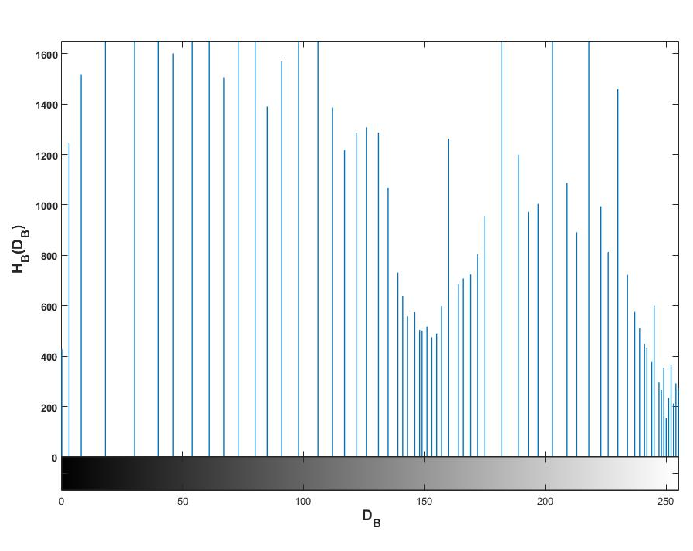
MATLAB Example
Using original 8-bit version of pout.tif
>>
Before
After
Resulting image uses more of dynamic range. Resulting histogram almost, but not completely, flat. Appears jagged and some gray levels unoccupied since finite number of gray levels are available.

Slide 10
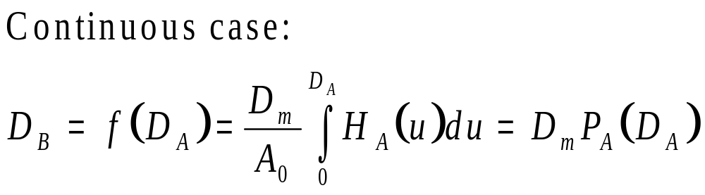
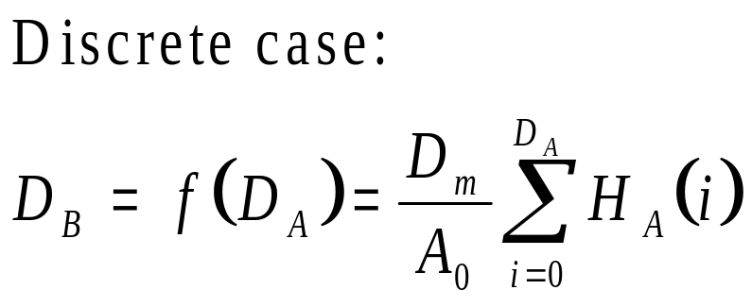
Summary
Defined histogram equalization
Developed formulae (cont & digital) for histogram equalization
Implementation (Asst)

